Slide 1
More Machine Learning in Python
By Viktor Reichert
Viktor.Reichert@Conteco.gmbh

Slide 2
There are several methods to deal with unbalanced data:
Collect more data of the minority class
Changing Weights of Lossfunction / use penalized models
Oversampling
Undersampling
Synthetic Othersampling

Slide 3
Correct scoring!
Accuracy should not be used for unbalanced Data!
There are different indicators derivable form a confusion matrix:
F1
Recall
Precision

Slide 4
SMOTE (Synthetic Minority Oversampling Thechnique)
Create new „synthetic“ Observations

Slide 5
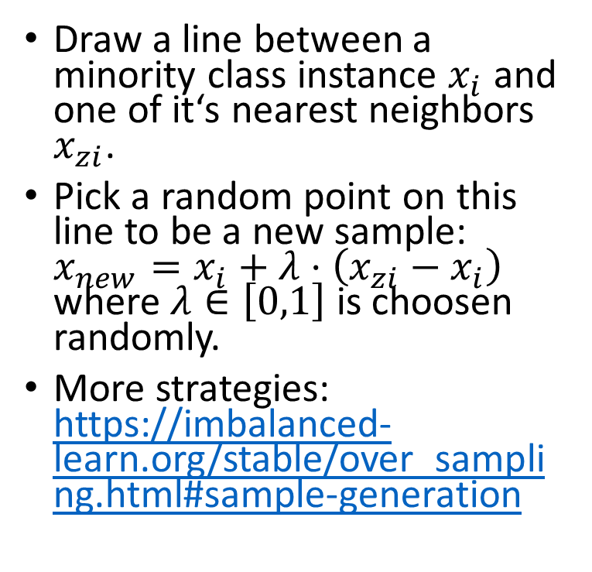



SMOTE
Draw a line between a minority class instance $x_{i}$ and one of it‘s nearest neighbors $x_{zi}$.
Pick a random point on this line to be a new sample: $x_{new}=x_{i}+λ⋅\left(x_{zi}−x_{i}\right)$ where $λ∈\left[0,1\right]$ is choosen randomly.
More strategies: https://imbalanced-learn.org/stable/over_sampling.html#sample-generation
$$x_{i}$$
$$x_{new}$$
$$x_{zi}$$

Slide 6
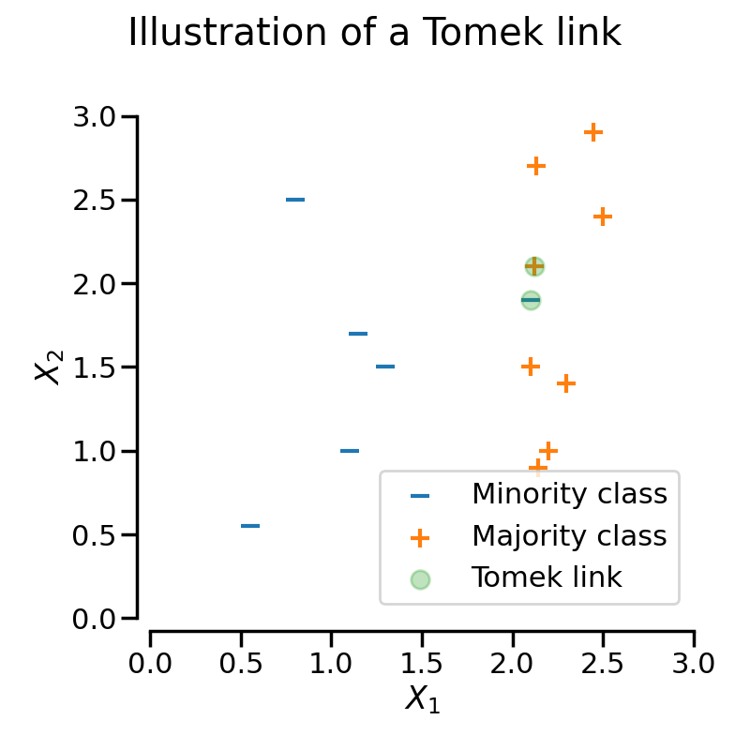
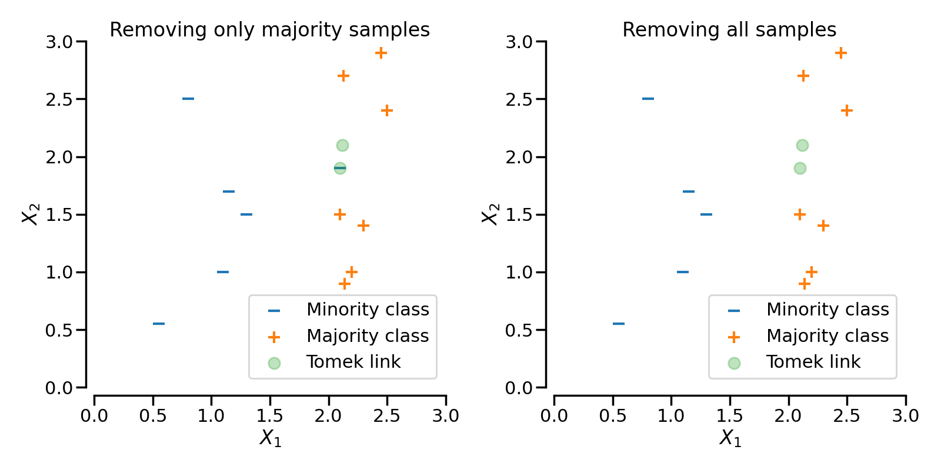
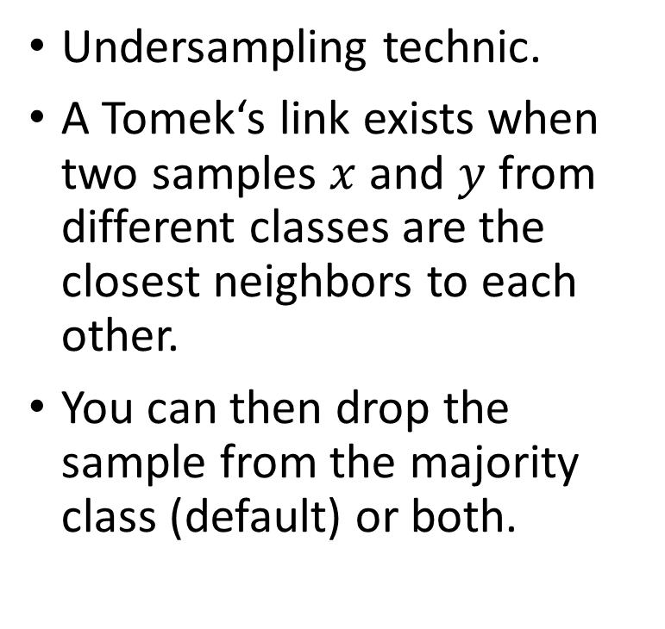
Tomek Links
Undersampling technic.
A Tomek‘s link exists when two samples $x$ and $y$ from different classes are the closest neighbors to each other.
You can then drop the sample from the majority class (default) or both.
sampling_strategy=‘auto‘
sampling_strategy=‘all‘

Slide 8
Missing Data
There are several ways to work with missing data:
Drop rows with missing data
Replacing with positional parameters (mean, mode, …)
Interpolating

Slide 9
Dropping Rows

Slide 10
Logistic Regression
Model for binary classification.
Estimates the probability of an outcome.
Uses the logistic function

Slide 11
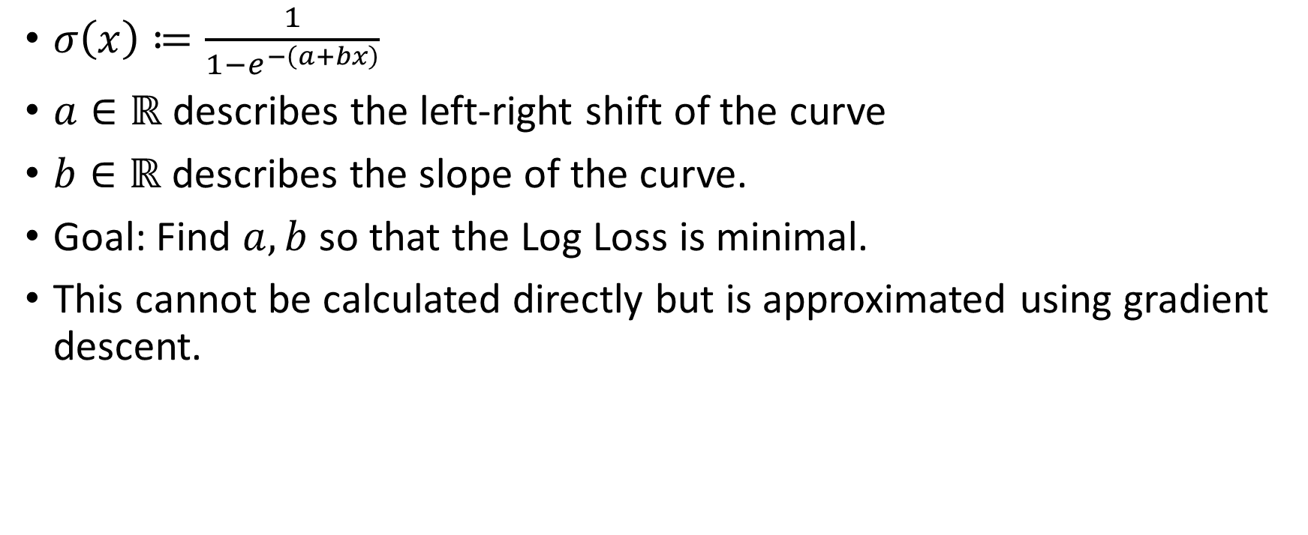
Logistic (Sigmoid) Function
$σ\left(x\right)≔\frac{1}{1−e^{−\left(a+bx\right)}}$
$a∈ℝ$ describes the left-right shift of the curve
$b∈ℝ$ describes the slope of the curve.
Goal: Find $a,b$ so that the Log Loss is minimal.
This cannot be calculated directly but is approximated using gradient descent.

Slide 12
Cox Regression
Survival Model
Developed by Sir David Cox (also pioniered Logistic Regression)

Slide 13


What is a survival Model?
Model that is concerned with the time of en event.
Death
Leaving facility cured
Unsubcribtion
End of Call
An event either occurs or is canceled
Cox tries to answer, what indipendent variables influece the occurance of the event.
Start
Start

Slide 14
Cancelation
Whenever the event does not occur the the sample counts as cancled.
There are several reasons for cancelation:
Experiment ended before Event happened.
Participant dropped out of survey.

Slide 15

Math of Cox Regression
$h\left(t\right)=h_{0}\left(t\right)⋅e^{b_{1}X_{1}+b_{2}X_{2}+…b_{K}⋅X_{K}}$
$\ln\left(\frac{h\left(t\right)}{h_{0}\left(t\right)}\right)=b_{1}X_{1}+b_{2}X_{2}+…b_{K}⋅X_{K}$

Slide 16

Linear Regression - revisited
$H_{1}:β_{k}≠0$

Slide 17
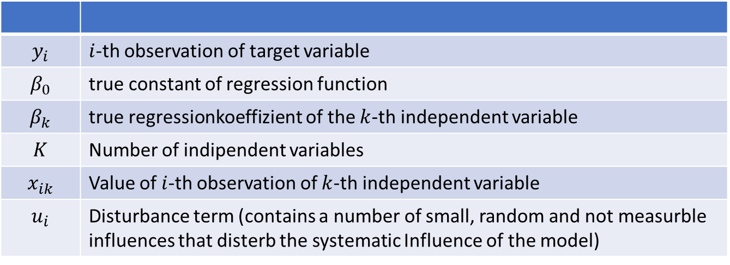

$$y_{i}=β_{0}+\sum_{k=1}^{K}{β_{k}⋅x_{ik}}+u_{i}=β_{0}+{β_{1}x}_{i1}+β_{2}x_{i2}+…+β_{K}x_{iK}+u_{i}$$
$$y_{i}$$ | $i$-th observation of target variable
$$β_{0}$$ | true constant of regression function
$$β_{k}$$ | true regressionkoeffizient of the $k$-th independent variable
$$K$$ | Number of indipendent variables
$$x_{ik}$$ | Value of $i$-th observation of $k$-th independent variable
$$u_{i}$$ | Disturbance term (contains a number of small, random and not measurble influences that disterb the systematic Influence of the model)

Slide 18

${\hat{y}}_{i}=b_{0}+\sum_{k=1}^{K}{b_{k}⋅x_{ik}}=b_{0}+{b_{1}x}_{i1}+b_{2}x_{i2}+…+b_{K}x_{iK}$
$$y_{i}$$ | $i$-th observation of target variable
$$β_{0}$$ | true constant of regression function
$$β_{k}$$ | true regressionkoeffizient of the $k$-th independent variable
$$K$$ | Number of indipendent variables
$$x_{ik}$$ | Value of $i$-th observation of $k$-th independent variable
$$u_{i}$$ | Disturbance term (contains a number of small, random and not measurble influences that disterb the systematic Influence of the model)

